Slide 1
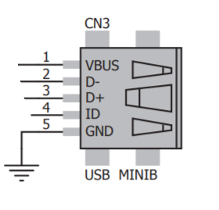
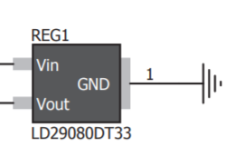

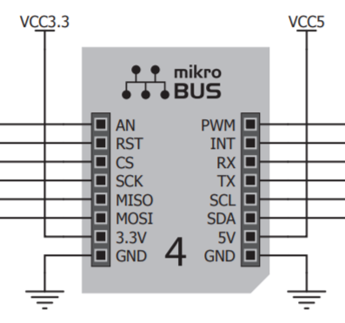
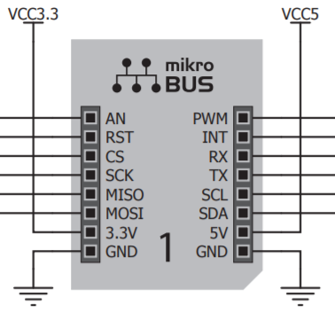

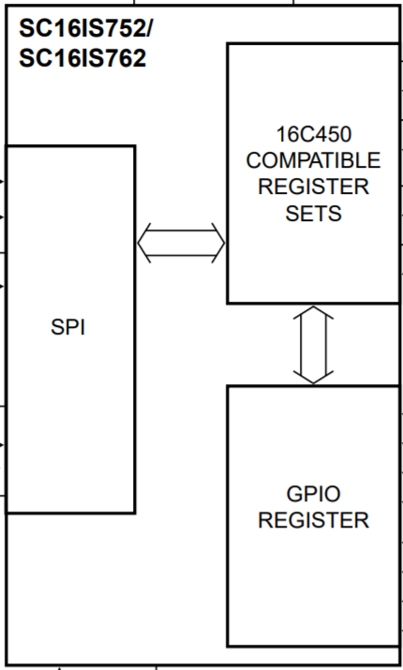



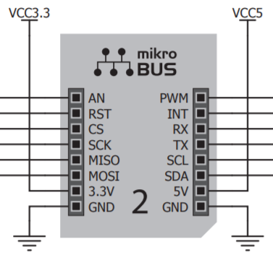
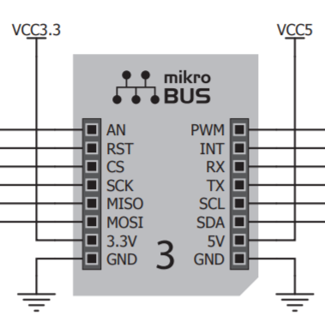
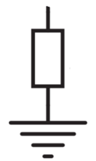
Power
Input
Voltage Regulator
2 channels 3.3V&5V
SPI
SPI TO UART
I2C
PWM
ANALOG
INTERRUPTER
RESET
Test Point
Reset Button
Convert
SPI to UART
J1
RX_1
RX_4
J4
TX_1
TX_4
PWM_1
SS_0
RX_2
RX_3
PWM_2
SS_1
TX_2
TX_3
AN_1
PWM_3
SS_2
AN_2
PWM_4
SS_4
AN_3
AN_4
ENCO_3
MOSI_1
ENCO_2
MISO_1
ENCO_1
CS_4
SCK_1
SCK_0
2:4
CS_3
MOSI_0
CS_2
MISO_0
CS_1
SDA
SCL
J2
Decoder 2 to 4
Select Slaves
J3
R1
SPI_SC_1
PTA14
R2
SPI_SC_2
Reset Button
INT_1
8:3
PTA6
INT_2
PTA7
INT_3
Test Point
INT_4
Priority Encoder 8 to 3
Interrupter

